Slide 1
LIN6209 Coding for Linguists
A miscellany of relevance

Slide 2
Last week – regular expressions
What is a regular expression?
Search
Searching for text that matches a given pattern
Search & Replace
Searching for text that matches a given pattern
Replacing that text with another pattern
Lexical analysis
Syntax analysis
Abstract syntax trees
BNF notations
Language translation
Compilers and interpreters
The syntax of Python

Slide 3
design
build
test
evaluate
analyse
requirements

Slide 4
This week – Python and other relevant topics
F strings
Doc strings
Try – Except
Classes
Scripts, Modules & Packages
Testing & debugging
PyPi & PIP
Data & Databases
SQL
Version control
Style guides & coding standards
Optimisation
IDE’s and other tools
Proprietary & Open Source software
Continuous Professional Development
Bias and ’isms in IT
The IT industry
Prospects
Problems
Employment

Slide 5
f strings
String formatting made easy

Slide 6
f'strings and why they are so useful'
Rather than this:
Do this:
age = 27
out = 'Age is'+str(age)
age = 27
out = f'Age is {age}'
§

Slide 7
Documentation and Docstrings
For when someone else has to fix your code
For when you have to fix someone else’s code

Slide 8
Meaningful names and comments
Object names
Inline comments
# meaningless names = bad
x, y, z = 0, 0, 0
# informative names = good
height, width, depth = 0, 0, 0
# Don't say the trivially obvious – for example # add cost and profit and tax
# and assign to price
price = cost + profit + tax

Slide 9
Documentation and Docstrings
You SHOULD document all code you intend to re-use
If you are working as part of a team you MUST document code
Classes, class methods and functions MUST have docstrings
Statements to have sensible comments, not verbiage
def f1():
""" answer the meaning
of life """
return 42 # hitchikers answer
f1
f1()
help(f1)
§

Slide 10
Try - Except
For when things go wrong

Slide 11
Try - Except
When Python encounters a problem it cannot fix it ‘raises an exception’
This cascades upwards through the code stack
If it is not ‘caught’ and dealt with before it gets to the top
The program crashes
try:
code to run that
may produce an exception
except:
execute this code if
there is an exception

Slide 12
Syntax Errors and Exceptions
Syntax error
Exception
# syntax is incorrect
print(1 / 0))
# the expression 1/0
# never evaluates
# syntax is correct
print(1 / 0)
# python attempts to
# evaluate 1/0

Slide 13
Try Except example
User may input incorrect data
Do not want program to crash because of that
num1_ok = false
while not num1_ok:
try:
age = int(input(‘age?’))
num1_ok = true
# but if it’s not a number
except ValueError:
print(‘Age is a number’)
print(‘input an integer’)
§

Slide 14
Classes
Creating your own datatypes

Slide 15
Classes – Designing your own datatypes
Numbers, lists, sets, strings are different datatypes
Each of them has many methods particular to themselves
The operator ‘+’ behaves differently for numbers and strings
They are Classes
Create your own classes with the ‘class’ statement

Slide 16
A Door Class – one class, many doors
class Door():
def __init__(self, color, height):
self.__color = color
self.__height = height
def set_color(self, color):
self.__color = color
def set_height(self, height):
self.__height = height
def __str__(self):
return f'This door is a’ ‘{self.__color} door and’ ‘is {self.__height} high'
# and create a few doors
red_door = Door('red', 2)
blue_door = Door('blue', 2.2)
# check they exist
print(red_door, '\n', blue_door)
# make the red door scarlet
red_door.set_color('Scarlet’)
# and check it has changed
print(red_door, '\n', blue_door)
§

Slide 17
Scripts, Modules & Packages
Modules and Packages facilitate modular programming

Slide 18
Scripts, Modules & Packages
A Python script is a:
.py file you directly execute in Python
A Python module is a:
.py file you import into your Python program
A Python package is a:
folder of .py files you import into your Python program

Slide 19
Modular programming
The process of breaking a large and complex programming task into separate, smaller and more manageable, subtasks
Instead of writing everything in a single very large script:
one_gargantuan_python_script.py
Separate related functions and tasks into separate modules:
small_control_script.py # uses the import statement for other modules
get_data_functions.py
clean_data_functions.py
summarise_data_functions
display_data_functions.py
§

Slide 20
Testing and Debugging
Untested code is (practically) guaranteed to be faulty

Slide 21
Testing
The assert statement
Does nothing if it evaluates to True
Raises an assert exception if false
Testing libraries
unittest – part of the standard library
Pytest – https://docs.pytest.org

Slide 22
Assert vs PyTest
Using assert statements
Using pytest library
import * from assignment
assert score_4(1, 5, 6, 6) == 7
assert score_4(3, 2, 3, 3) == 2
assert score_4(2, 6, 1, 5) == 14
assert score_4(1, 2, 3, 4) == 1
assert score_4(3, 3, 3, 4) == 7
assert score_4(3, 3, 4, 4) == 21
assert score_4(4, 3, 3, 4) == 21
# runs to the first test that fails
import * from assignment
def test_score_4():
assert score_4(1, 5, 6, 6) == 7
assert score_4(3, 2, 3, 3) == 2
assert score_4(2, 6, 1, 5) == 14
assert score_4(1, 2, 3, 4) == 1
assert score_4(3, 3, 3, 4) == 7
assert score_4(3, 3, 4, 4) == 21
assert score_4(4, 3, 3, 4) == 21
# ALL test ALWAYS run
# AND a report is produced
§

Slide 23
PIP and PyPi

Slide 24
Finding and Installing Python Packages
(Anaconda already includes the packages you are most likely to need)
PyPi
The default Package Index for the Python community https://pypi.org/
PIP
The most popular tool for installing Python packages
Included with most versions of Python.
On MacOS or UNIX: python3 -m pip install "SomeProjectName"
On Windows: py -m pip install "SomeProjectName"
Virtual (Python) Environments
Create multiple, completely separate Python environments on your PC

Slide 25
Databases, SQL and noSQL
What to do with your data

Slide 26
Why use a database instead of files?
Pros
Cons
Data integrity rules built-in
Data normalised, no redundancy
Comprehensive management of
Users
Security and access control
Concurrency
Transactions and change logging
Snapshots and backups
Complex setup
Specialised query language
Can be costly (people and s/w)
Specialised skills

Slide 27
Types of Database
Relational
Non-Relational / noSQL
Dominant model
Ideal for most business purposes
Data organised into separate tables
Relationships defined between tables maintain integrity
Products available for all speed and data requirements
Hierarchical, Object, noSQL, Graph, and more
Specialised uses

Slide 28
SQL = Structured Query Language
Relational database language
In use since 1970’s
Has been standardised (beware of proprietary ‘enhancements’)
Almost all languages can ‘talk’ SQL to relational databases
Used to define database structure & integrity rules, to import data, query data, modify data, and manage data
# example 1
SELECT *
FROM Customers
WHERE Country='Mexico';
# example 2
SELECT name, salary, grade
FROM employee
WHERE salary < 10000
ORDER BY grade DESC

Slide 29
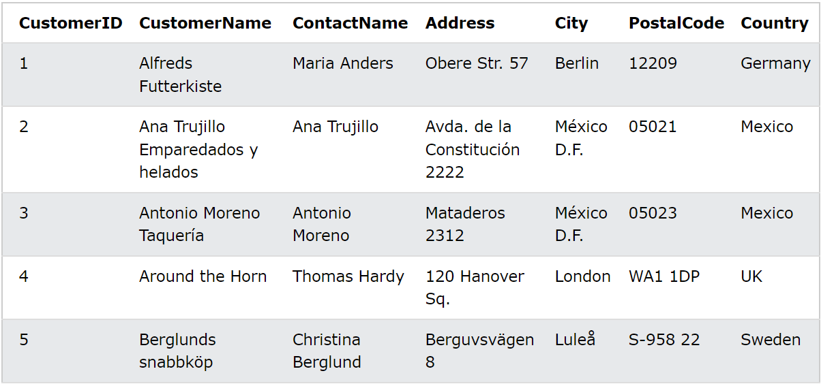
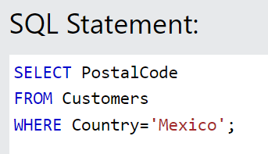
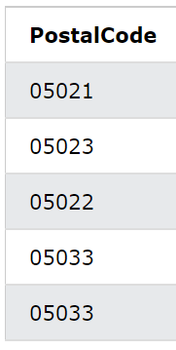
A relational DB table, SQL query, and result
86 more records
§

Slide 30
Version Control Software

Slide 31
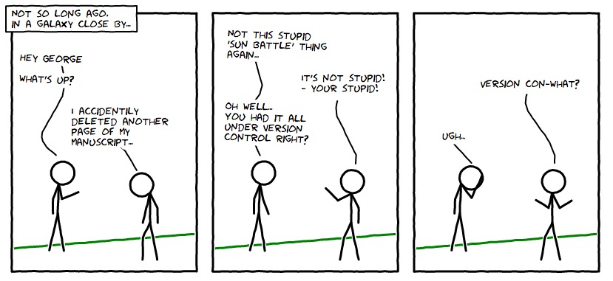

Slide 32
The applications of version control
Ever had this experience
You start writing an essay
You write and you edit, delete, cut, paste, and add write some more
But then – disaster – you ‘know’ the version you wrote yesterday was better
But ‘undo’ isn’t doing it
Or
You’re writing a novel and have multiple alternate plotlines
So you start writing several versions
And then you try and pull them together
In multiple ways

Slide 33
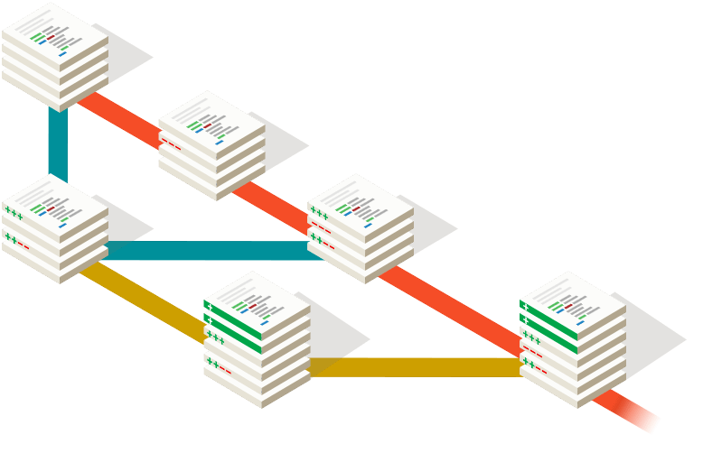
Version Control Software
version v1.0
Every change is tracked
Every version is archived
Every update is reversible
start VCS
v1.1 = v1.0 debugged
v1.2 = more bugs removed from v1.1
and new feature merged in
new
feature
v1.3 = v1.2 updated
with improved and
debugged new feature
new
feature
improved & debugged
See: git and GitHub

Slide 34
Best & Good Enough Practices for Scientific Computing

Slide 35
Developing software for research
Top tips https://software.ac.uk/resources/top-tips
Best Practices: https://journals.plos.org/plosbiology/article?id=10.1371/journal.pbio.1001745
Good enough practices in scientific computing: https://journals.plos.org/ploscompbiol/article?id=10.1371/journal.pcbi.1005510

Slide 36
Integrated Development Environments
Commercial: JetBrains, Microsoft
Open source: Eclipse, Netbeans, Spyder,

Slide 37
What are IDEs good for
They must be good for something – they are expensive
Dynamic syntax checking, coding hints, multiple build and execution environments, built-in version control, powerful debugging, performance profiling, testing, and more
PyCharm by JetBrains: https://youtu.be/BPC-bGdBSM8
MSFT Visual Studio: https://www.youtube.com/channel/UChqrDOwARrxdJF-ykAptc7w
Both free to academic developers (that’s you)

Slide 38
IDEs – a word of caution
IDEs have LOTS of features
This is initially confusing and takes a while to learn
That means when you start using an IDE your productivity usually goes DOWN before it goes up
A good way to start is just to use them as syntax checkers when writing your scripts. Ignore all their other features until you start feeling comfortable with that

Slide 39
Optimisation & Benchmarking
If you really cared about code performance you would not be using Python

Slide 40
Optimisation & Benchmarking
The best optimisation is choosing the best algorithm
Use Big O notation to determine asymptotic behaviour
Beyond that, and until you know a lot more – don’t bother
Leave optimisation to the compiler
Professional IDE’s include performance benchmarking and profiling tools to identify bottlenecks in code

Slide 41
Proprietary Software Open Source Software
What’s the difference and what are they good for?

Slide 42
Open Source Software
The source code is available
The compiled executable code may be available
The license grants the rights to use, study, change, and distribute the software and its source code to anyone and for any purpose
The ability to examine the code facilitates public trust in the software
An example of open collaboration
Any capable user is able to participate in development
Examples: Python, Jupyter, Anaconda, Linux, Libra Office, Apache …

Slide 43
Proprietary Software
Only the compiled executable code is available
There is sometimes a license fee to pay
The licence prohibits attempting to decompile the code
Examples: Microsoft Office, WhatsApp, WeChat, Twitter, YouTube
There is a growing synergy between open & proprietary software

Slide 44
Continuous Professional Development
IT does not stand still
Skills ALWAYS need to be refreshed and updated

Slide 45
What do new coders think?
https://www.freecodecamp.org/news/2021-new-coder-survey-18000-people-share-how-theyre-learning-to-code/

Slide 46
What do experienced coders think?
https://www.tiobe.com/tiobe-index/
https://www.nature.com/articles/d41586-021-00075-2

Slide 47
Bias and ’isms in IT
Racism, Sexism, Ageism, Sectarianism, … and more

Slide 48
Currently, the typical IT employee is
Male
Caucasian or Asian
< 45 years of age
Blind studies (not in IT) have repeatedly shown that bias is routine
Men rated more capable vs Women rated more likeable
Youth vs age
Experience vs ability
Certificates as proxies for ability
See papers in QM+ folder

Slide 49
Bias in Software
“Garbage in → Garbage out”
IT jargon, first use dated to November 10, 1957

Slide 50
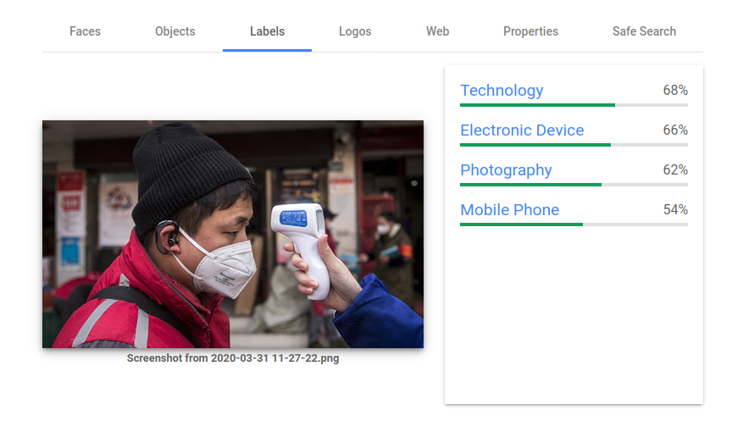
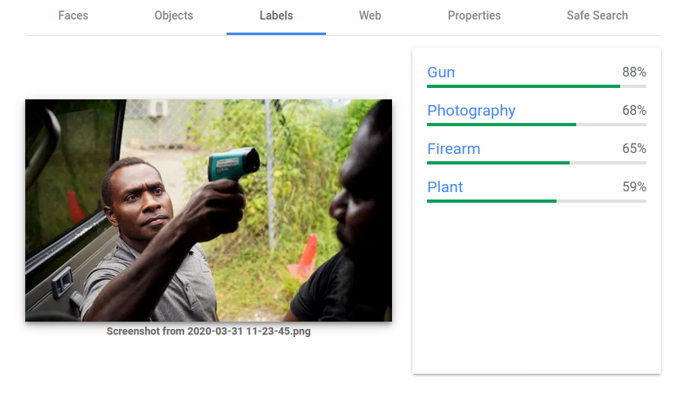
Bias in AI – an example from 2020
Model performance reflects the characteristics of the training data
Bias in training data will be accurately modelled
The model has no understanding, it’s just finding patterns

Slide 51
The impact of AI
The BBC Reith Lectures 2021
https://www.bbc.co.uk/sounds/play/m001216j
A small selection of press articles on AI in QM+ w12 folder

Slide 52
Bias in technology
All forms of technology are susceptible to bias
Blood Oximeters
Are less accurate when used on darker skins
Effect known since 2007 but not reported (on BBC) until 2021
Biased data in → biased model out

Slide 53
The IT Industry
Getting in, what it’s like, and getting on

Slide 54
Dismiss the Hollywood stereotype
Working in IT is the complete opposite
Working in teams and across teams – people skills are very important
Multiple complementary skillsets
Many highly specialised roles
Business analyst, systems analyst, data analyst, developer (front‑end, back‑end, full‑stack, multiple languages), operations, infrastructure, security, testing, project manager, product manager, scrum master, database designer, SQL developer, technical writer, network engineer, graphic designer, user experience (UIX) designer, …

Slide 55
Growing Areas of IT
Cloud Services – ‘everything’ computing is moving to the cloud
Parallel evolution to the discovery of electricity: MSFT, Google, AWS
Text
Mining the enormous quantities of ‘text’ data companies hold
Endless opportunities especially summarisation & sentiment analysis
Vision
Researchers train AI on synthetic data to uncover Syrian war crimes
https://www.ft.com/content/8399873e-0dda-4c87-ba59-0e2678166fba
Voice
Human-computer interface “Is voice tech set to change the way we work?”
https://www.ft.com/content/8b45f858-b2f4-11e9-b2c2-1e116952691a

Slide 56
Employment
Prospects excellent
See for example cwjobs.co.uk or dice.com

Slide 57
Getting a Job – CVs and letters of application
Do not hide information but only share what will help get you the job
Applications routinely filtered by s/w
Read the job specification & advertisements (the s/w is trained on this)
Read other jobs posted by the same company or agency for comparison
Use KEY WORDS from the advertisement and your knowledge of employer
Say what YOU have DONE and what you will DELIVER to employer
Human readers rarely read beyond one page
Foreground your achievements, what you will deliver, and reasons to hire you
Have a portfolio of your experience / projects / achievements ready

Slide 58
Good Luck

Slide 59
LIN 6209 Coding for Linguists
The end of the beginning

